Slide 1
World Economic Outlook Tableau Dashboard
File created on: 3/15/24 10:20:47 PM PDT

Slide 2
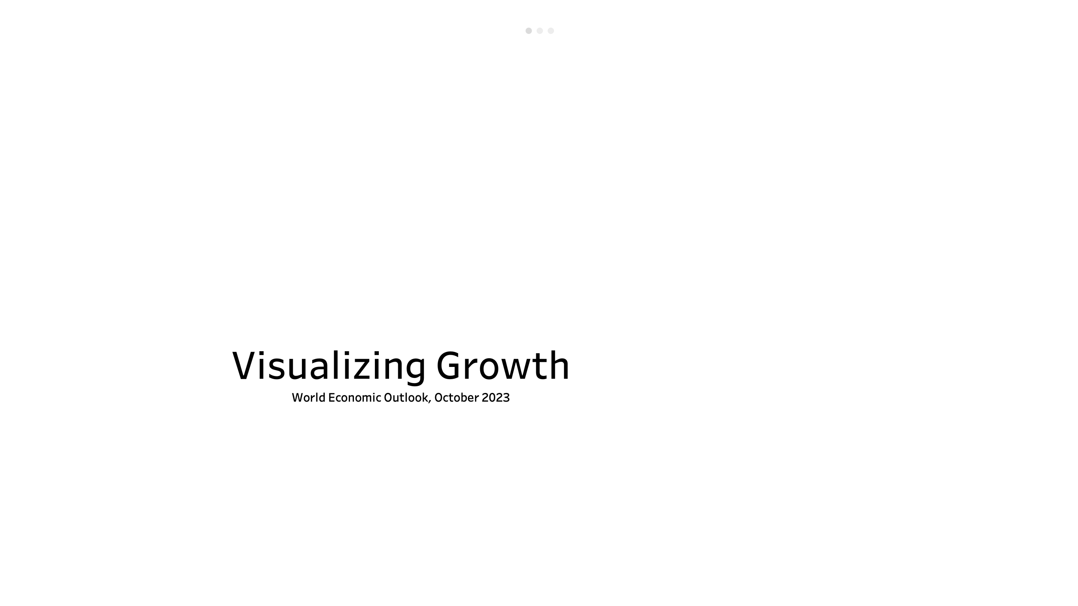

Slide 3
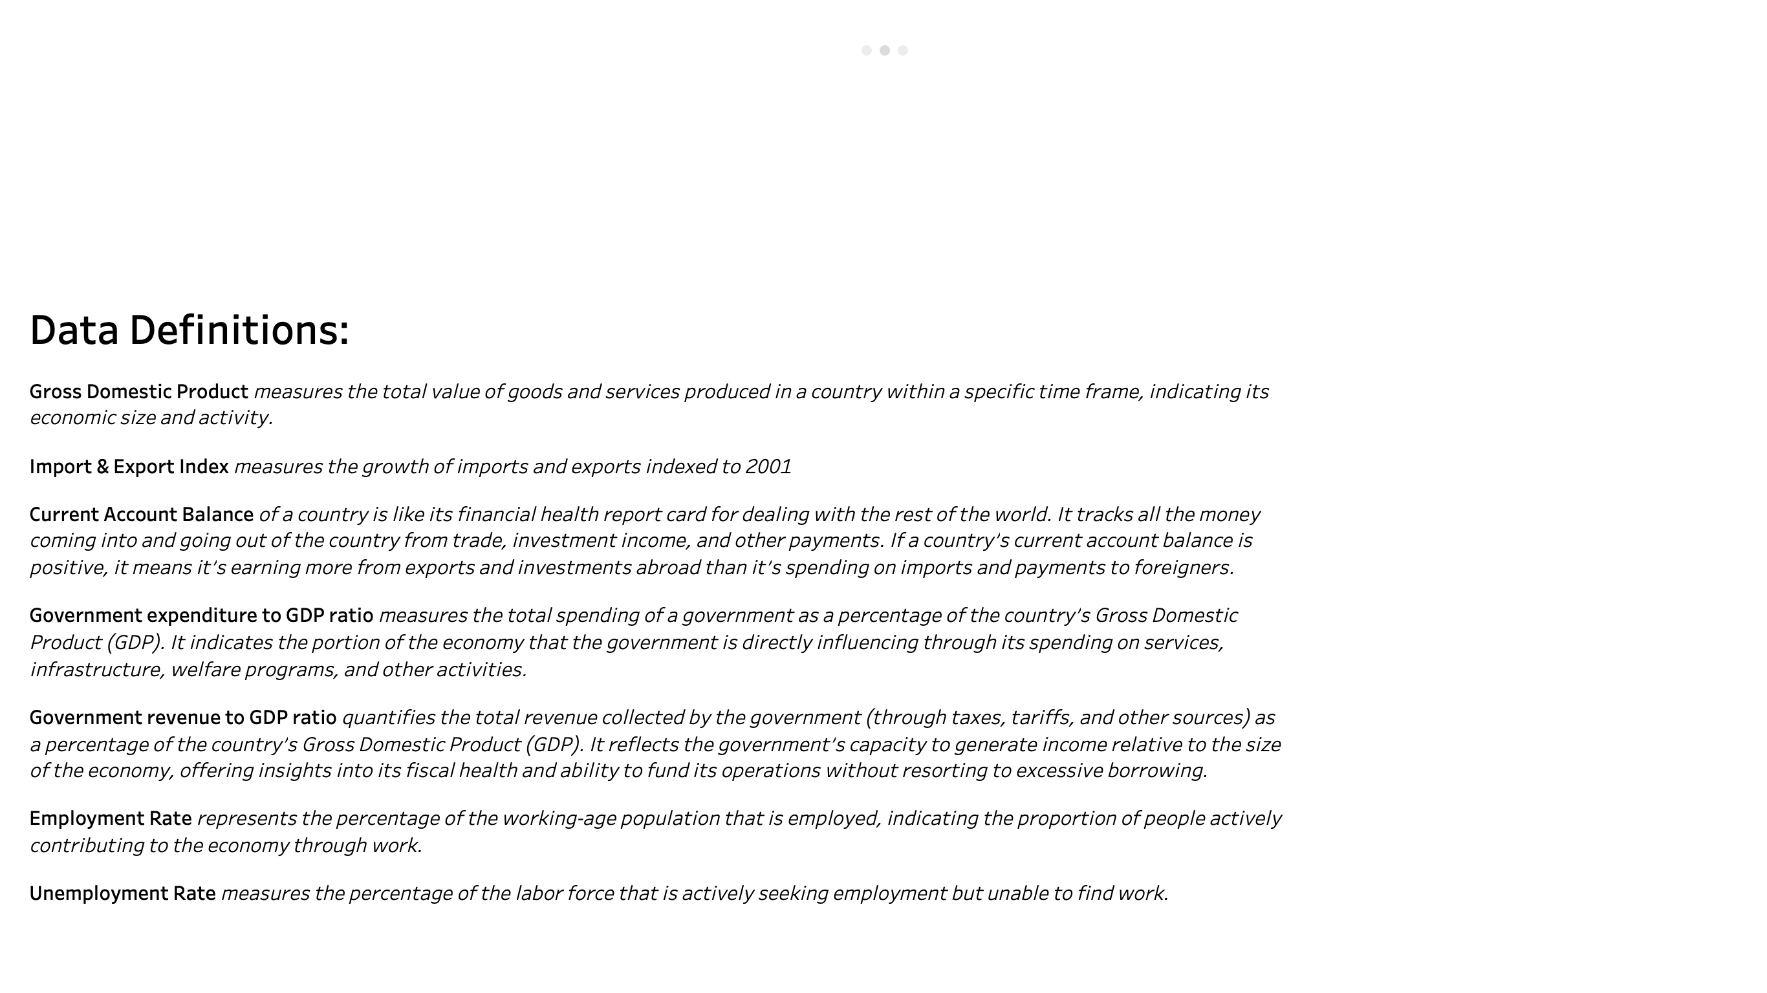

Slide 4
